Slide 1
MACOM Diode Limiter Products
Rick Cory, Joe Bukowski
3 March 2017

Slide 2
PRODUCT FAMILIES
PIN/NIP Diodes:
Switching
Attenuation
Limiting
Varactor Diodes:
Tuning
Phase Shifting
Schottky Diodes:
Detection
Frequency Mixing
Diode Products
Attenuators
Multiplier Diodes:
Frequency Multiplication
Waveshaping
Passive Devices
RF Chokes/Inductors
MNS Capacitors
Resistors

Slide 3
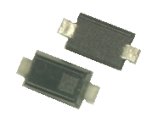

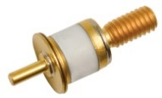


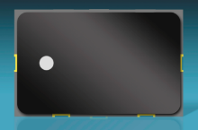
LIMITER PRODUCT CONFIGURATIONS
Plastic
(to 6 GHz)
Discrete Device
Bare Die
(to 18 GHz)
Hermetic Packaged
(to 12 GHz)
Integrated Solutions
Hybrid Solutions
Multichip Modules
(to 8 GHz)

Slide 4
Transceiver Block Diagram

Slide 5
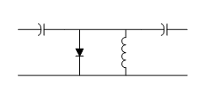
Discrete Diodes – Limiters
Limiter diodes can be thought of as RF-voltage-controlled variable attenuators
When input signal is small,
limiter diode impedance is high
RF signal is not attenuated
When RF signal is large,
it forces the diode’s impedance to be small
input signal is reflected back to its source

Slide 6
Discrete Diodes – Limiters (cont’d)
No external control signal is required for the limiter to operate
DC current return path (e.g., RF choke) is required
Diode I layer thickness determines input power level at which the limiter “turns on”
Threshold level = input 1 dB compression point

Slide 7
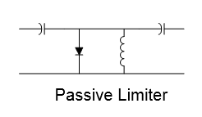
PIN Diode Parameters for Limiters
Capacitance determines insertion loss
I layer thickness determines
Threshold level (input 1 dB compression point)
Spike leakage
Recovery time
Resistance determines flat leakage
Shunt
Diode
TAKEAWAY: Limiter design is not done with simulators —experience is required!

Slide 8
Limiter Performance vs. Time
A limiter diode cannot go into conduction instantaneously
Leading edge of large RF signal is initially unattenuated resulting in spike leakage
As charge carriers accumulate in limiter I layer
Series resistance decreases
Attenuation increases due to mismatch loss
When the diode’s resistance reaches equilibrium,
some power is passed by the limiter
a small portion of the incident power is dissipated by the diode
the remainder is reflected to its source

Slide 9
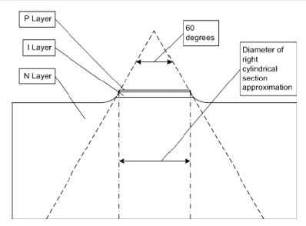

Junction Heating – the Enemy of All Semiconductors
When the limiter diode is conducting, Joule heating (I_{RF}²R_{S}) causes the junction temperature to rise
The diode acts as a network containing thermal resistance (θ_{JC}) and thermal capacitance (C_{thermal})
Junction temperature rises according to the thermal time constant of the diode
The maximum rated junction temperature for a Si PIN diode is 175 °C
$$τ_{th}=θ_{JC}C_{thermal}$$

Slide 10
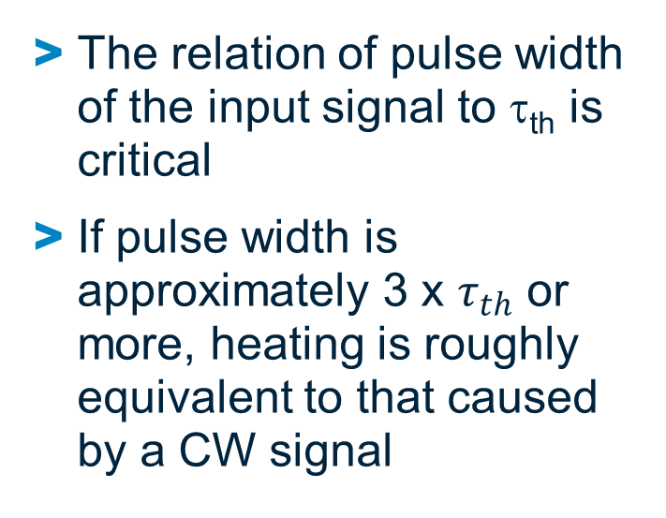
Junction Heating – the Enemy of All Semiconductors (cont’d)
The relation of pulse width of the input signal to τ_{th} is critical
If pulse width is approximately 3 x $τ_{th}$ or more, heating is roughly equivalent to that caused by a CW signal
$$Heating:T_{J}\left(t\right)=T_{case}+P_{dissipated}×θ_{JC}\left(1−e^{\frac{−t}{τ_{th}}}\right)$$

Slide 11
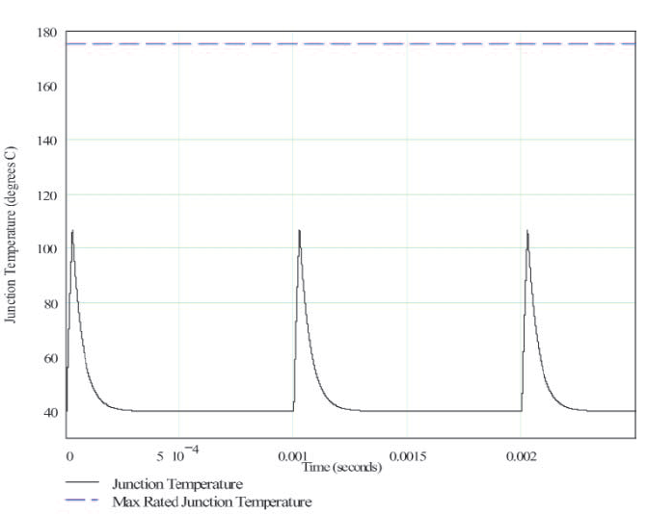
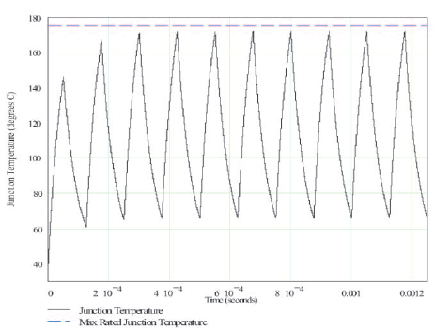

Junction Heating – the Enemy of All Semiconductors (cont’d)
Low Duty Cycle
High Duty Cycle
The relation of duty cycle to τ_{th} is critical
If duty cycle is too large, due to insufficient cooling times successive pulses cause peak junction temperature to sequentially increase
$$Heating:T_{J}\left(t\right)=T_{case}+P_{dissipated}×θ_{JC}\left(1−e^{\frac{−t}{τ_{th}}}\right)$$
$$Cooling:T_{J}\left(t\right)=T_{peak}\left(e^{\frac{−t}{τ_{th}}}\right)$$

Slide 12
Discrete Diodes – Limiters
Limiter diodes available
Die Versions (to 20 GHz)
In Ceramic & Plastic Packages (up to 12 GHz)
Low Capacitance
I layers from 2 µm to 40 µm
Cascadable for Increased Power Handling and Limiting
Thinnest diode placed at output stage
Determines threshold level, spike leakage
Thickest diode placed at input stage
Determines power handling, recovery time
I standing wave
V standing wave
Thick “coarse” limiter
λ/4
Thin “clean-up” limiter

Slide 13
Limiter Products

Slide 14
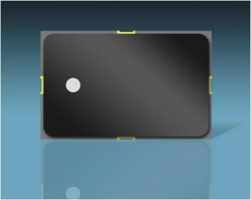
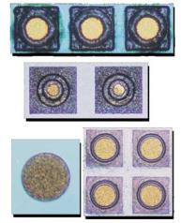

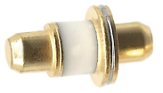
Receiver Protector Limiter
Modules and Discrete Limiter Diodes
Limiter Modules
Frequency 500 MHz – 8 GHz in octave bands
Power handling up to 200 W CW, 2 kW peak
Threshold level as low as 7 dBm
Non-hermetic:
5 x 8 mm SMT ceramic package
Hermetic
6 x 10 mm SMT ceramic package
Limiter Diodes
Frequency: 50 MHz – 18+ GHz
I layers from 1.5 to 40 µm
Power handling: up to 200 W CW, 2 kW peak
Available in many package styles:
Chip
Ceramic package
Plastic SMT

Slide 15
Limiter Diodes

Slide 16
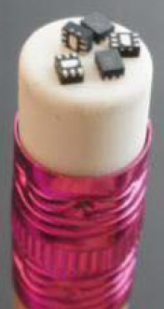
Discrete Limiter Products
Broadband Performance to 12 GHz and Higher
Several Packages Available Including
Low Inductance Shunt Configuration Plastic 1.5 X 1.2 mm DFN
Ceramic
Chips
Cascadable
Schottky-Limiter-PIN Shunt Antiparallel Pair
Shunt Limiter PIN
Limiter PIN

Slide 17
Discrete Diodes – Limiters
Die Versions (operate to 20+ GHz)
Available in Ceramic & Plastic Packages (operate to 12+ GHz)
Low Capacitance
Cascadable for Increased Power Handling and Limiting
Au-doped and non-Au-doped diodes available to optimize recovery time and flat leakage power
Part Number | Min V_{B} | Max V_{B} | Min C_{j} @ 0 V | Max C_{j} @ 0 V | Max Rs @ 10 mA | Nominal Characteristics
 |  |  |  |  |  | Carrier Lifetime | Intrinsic Region Thickness | Contact Diameter | Thermal Resistance
 | V | V | pF | pF | Ω | ns | μm | mils | ºC/W
MA4L011-134 | 15 | 35 | 0.08 | 0.18 | 2.10 | 10 | 2 | 1.2 | 175
MA4L021-134 | 20 | 35 | 0.10 | 0.20 | 2.10 | 10 | 2 | 1.2 | 175
MA4L022-134 | 20 | 35 | 0.09 | 0.19 | 2.00 | 10 | 2 | 1.2 | 175
MADL-011009-0134 | 20 | 35 | 0.16 | 0.23 | 1.50 | 10 | 2 | 3.0 | 175
MA4L031-134 | 30 | 50 | 0.14 | 0.21 | 2.00 | 20 | 3 | 1.4 | 150
MA4L032-134 | 30 | 50 | 0.13 | 0.20 | 2.50 | 15 | 3 | 1.5 | 150
MADL-011010-0134 | 30 | 50 | 0.17 | 0.24 | 1.50 | 15 | 3 | 3.0 | 150
MA4L062-134 | 60 | 75 | 0.07 | 0.15 | 2.50 | 10 | 4 | 1.5 | 150
MADL-011011-0134 | 60 | 75 | 0.05 | 0.17 | 2.30 | 10 | 4 | 3.0 | 150
MA4L101-134 | 100 |  |  | 0.15 | 2.00 | 90 | 13 | 3.5 | 30
MADL-000301-0134 | 200 |  |  | 0.20 | 1.50 | 200 | 20 | 3.0 | 30
MA4L401-134 | 250 |  |  | 0.30 | 1.20 | 800 | 25 | 4.5 | 25

Slide 18
Discrete Diodes – Limiters (cont’d)
Die Versions (operate to 20+ GHz)
Available in Ceramic & Plastic Packages (operate to 12+ GHz)
Low Capacitance
Cascadable for Increased Power Handling and Limiting
Part Number | Min V_{B} | Max V_{B} | Typ C_{j} @ 0 V | Max C_{j} @ 6 V | Typ Rs @ 10 mA | Nominal Characteristics
 |  |  |  |  |  | Carrier Lifetime | Intrinsic Region Thickness | Contact Diameter | Thermal Resistance
 | V | V | pF | pF | Ω | ns | μm | mils | ºC/W
MLP7100 | 20 | 45 | 0.2 | 0.15 | 1.5 | 5 |  |  | 100
MLP7101 | 20 | 45 | 0.5 | 0.3 | 1.2 | 10 |  |  | 80
MLP7102 | 20 | 45 | 0.7 | 0.5 | 1.0 | 10 |  |  | 55
MLP7110 | 45 | 75 | 0.2 | 0.15 | 1.5 | 10 |  |  | 80
MLP7111 | 45 | 75 | 0.5 | 0.3 | 1.2 | 15 |  |  | 60
MLP7112 | 45 | 75 | 0.7 | 0.5 | 1.0 | 20 |  |  | 40
MLP7120 | 120 | 180 | 0.2 | 0.15 | 1.5 | 50 |  |  | 40
MLP7121 | 120 | 180 | 0.6 | 0.3 | 1.2 | 50 |  |  | 20
MLP7122 | 120 | 180 | 0.8 | 0.5 | 0.5 | 100 |  |  | 15
MLP7130 | 15 | 30 | 0.12 | 0.10 | 2.0 | 5 |  |  | 120
MLP7131 | 15 | 30 | 0.2 | 0.15 | 1.5 | 5 |  |  | 80
MLP7140 | 30 | 60 | 0.12 | 0.10 | 2.0 | 7 |  |  | 100
MLP7141 | 30 | 60 | 0.2 | 0.15 | 1.5 | 7 |  |  | 70

Slide 19
Limiter Modules

Slide 20

High Power Limiter Modules
Industry-leading input power handling as high as
250 W CW
1 kW peak
No external control signal or external bias required
Available as
Single stage
Dual stage
Detector/limiter
Available in VHF, UHF, L, S and C bands
Packaged in low-thermal-resistance surface-mount hermetic or nonhermetic module packages
Custom designs are possible

Slide 21
Limiter Modules Maximum CW Power vs. Frequency

Slide 22
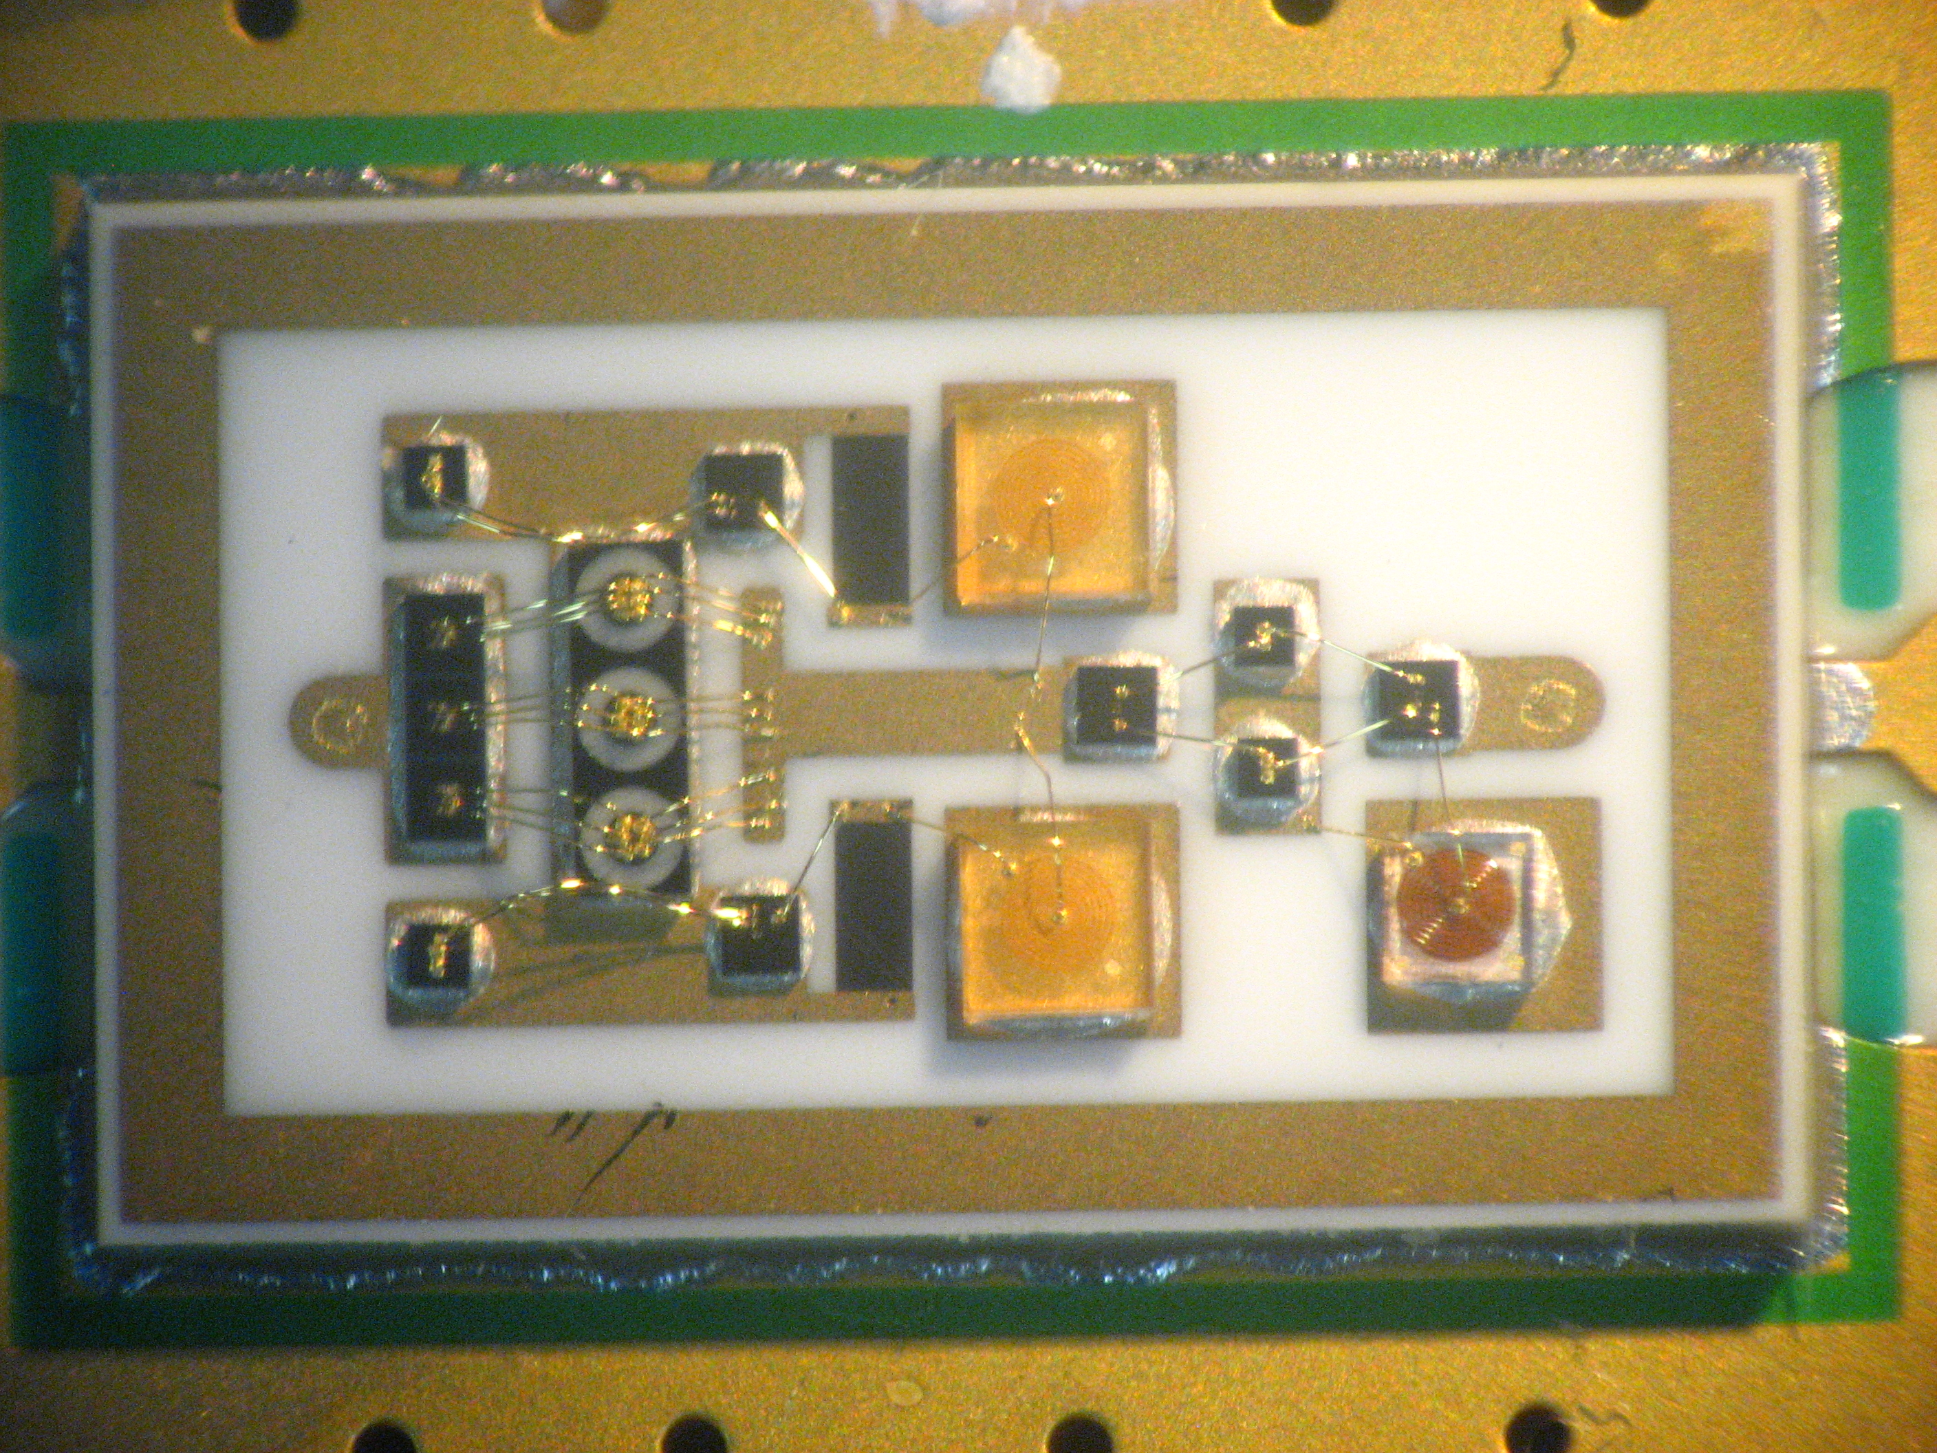
What’s Inside a Limiter Module? MADL-011014

Slide 23
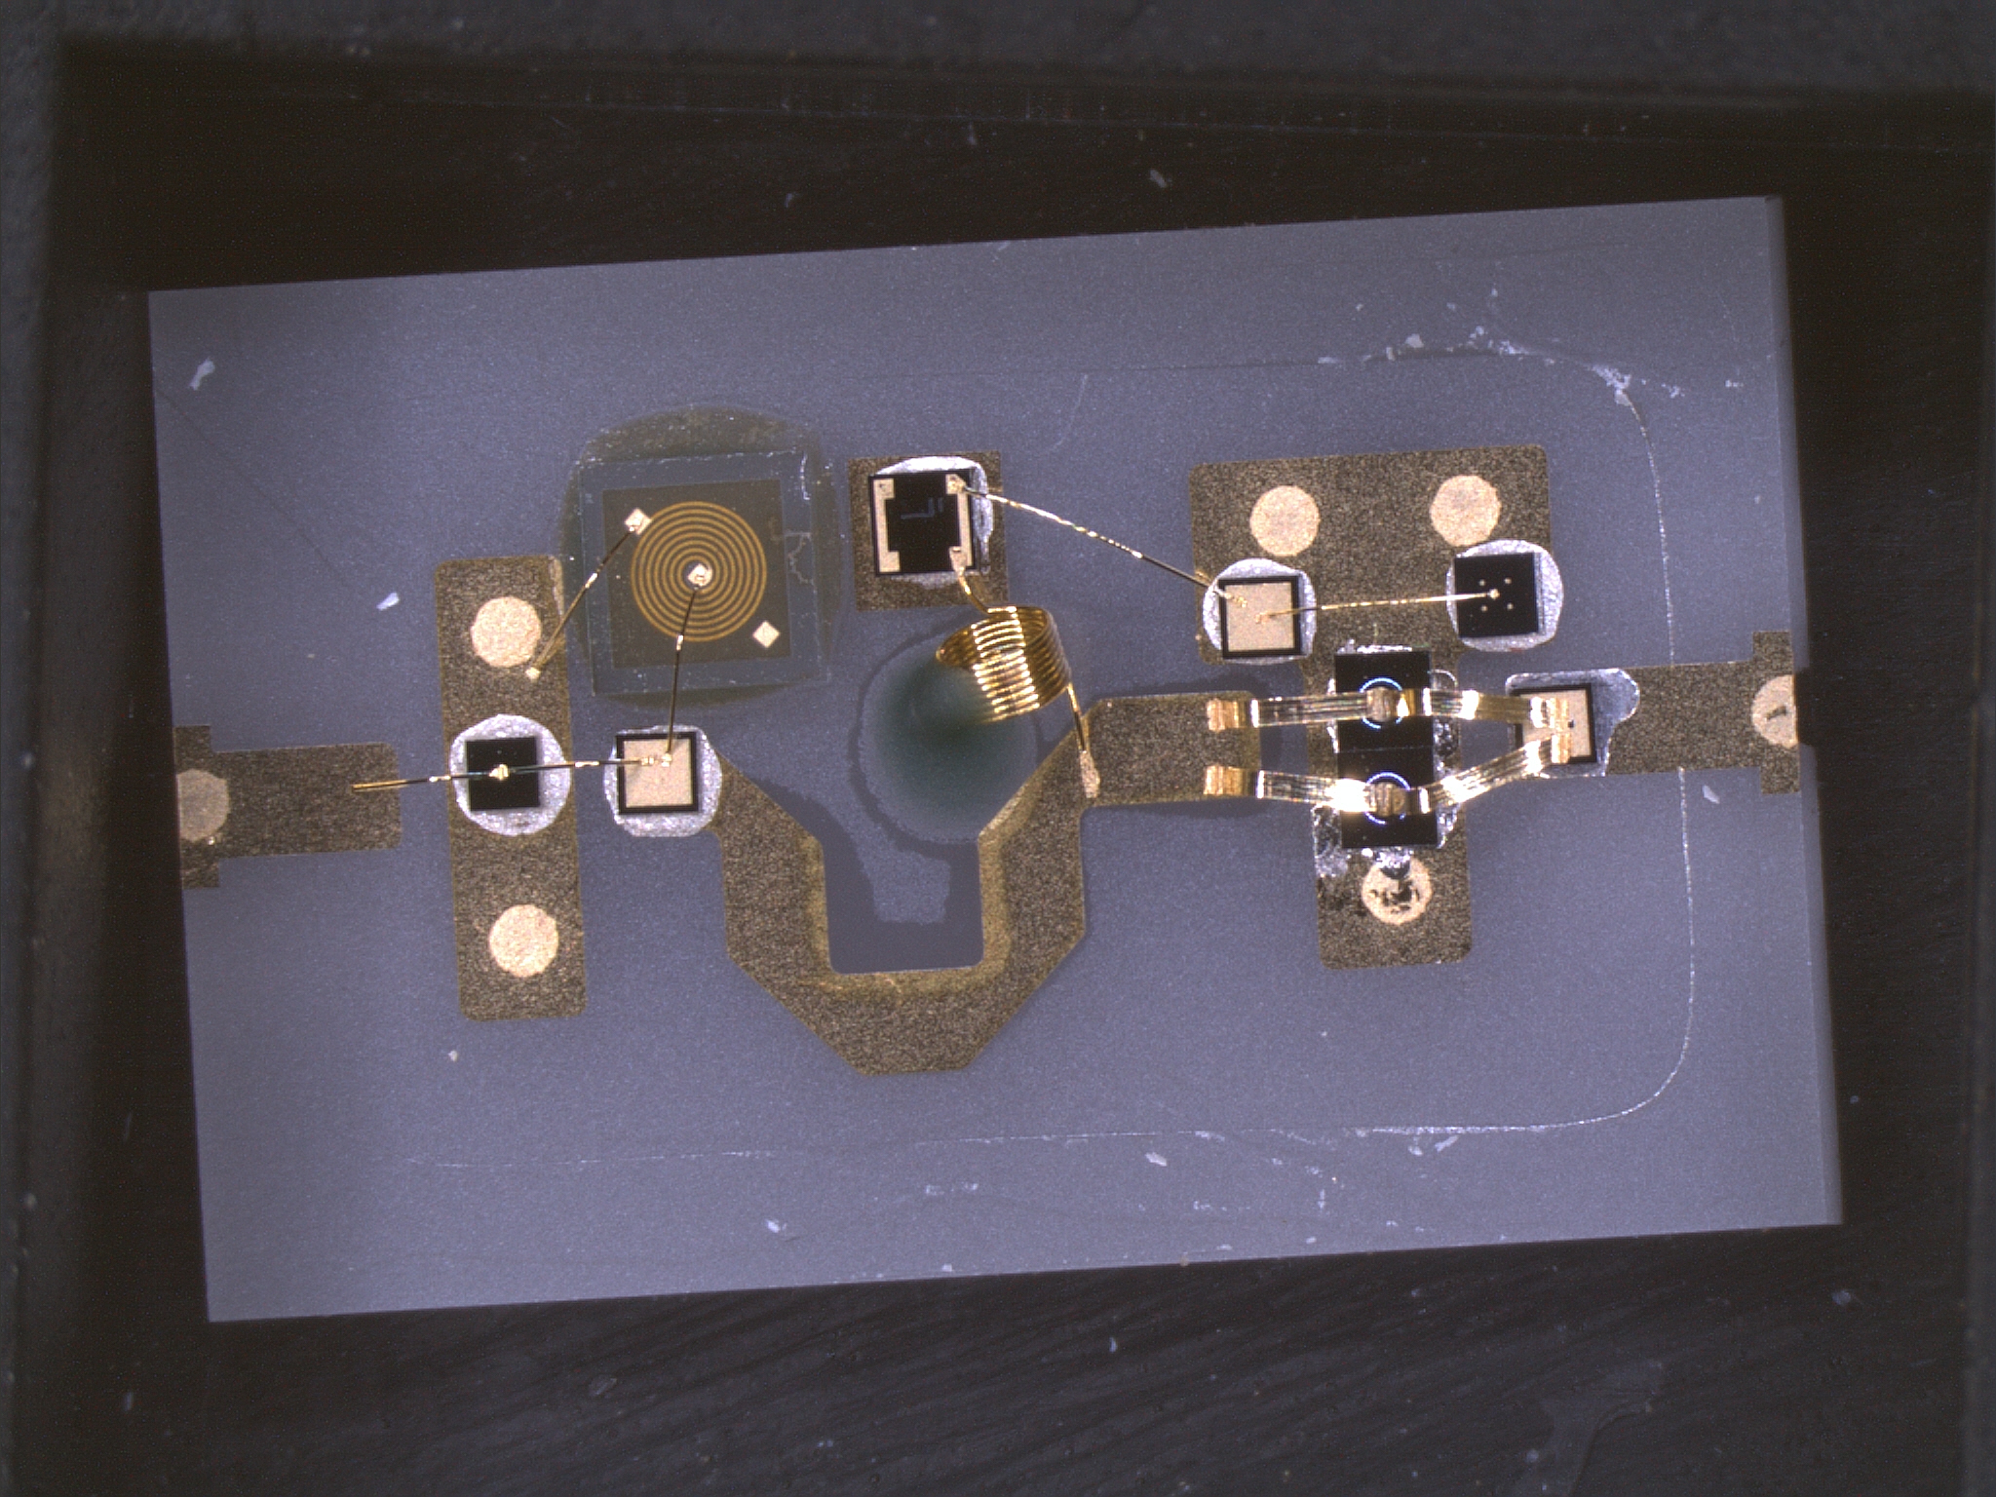
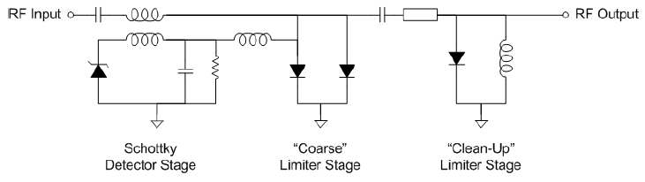
What’s Inside a Limiter Module? LM202402-Q-B-301

Slide 24
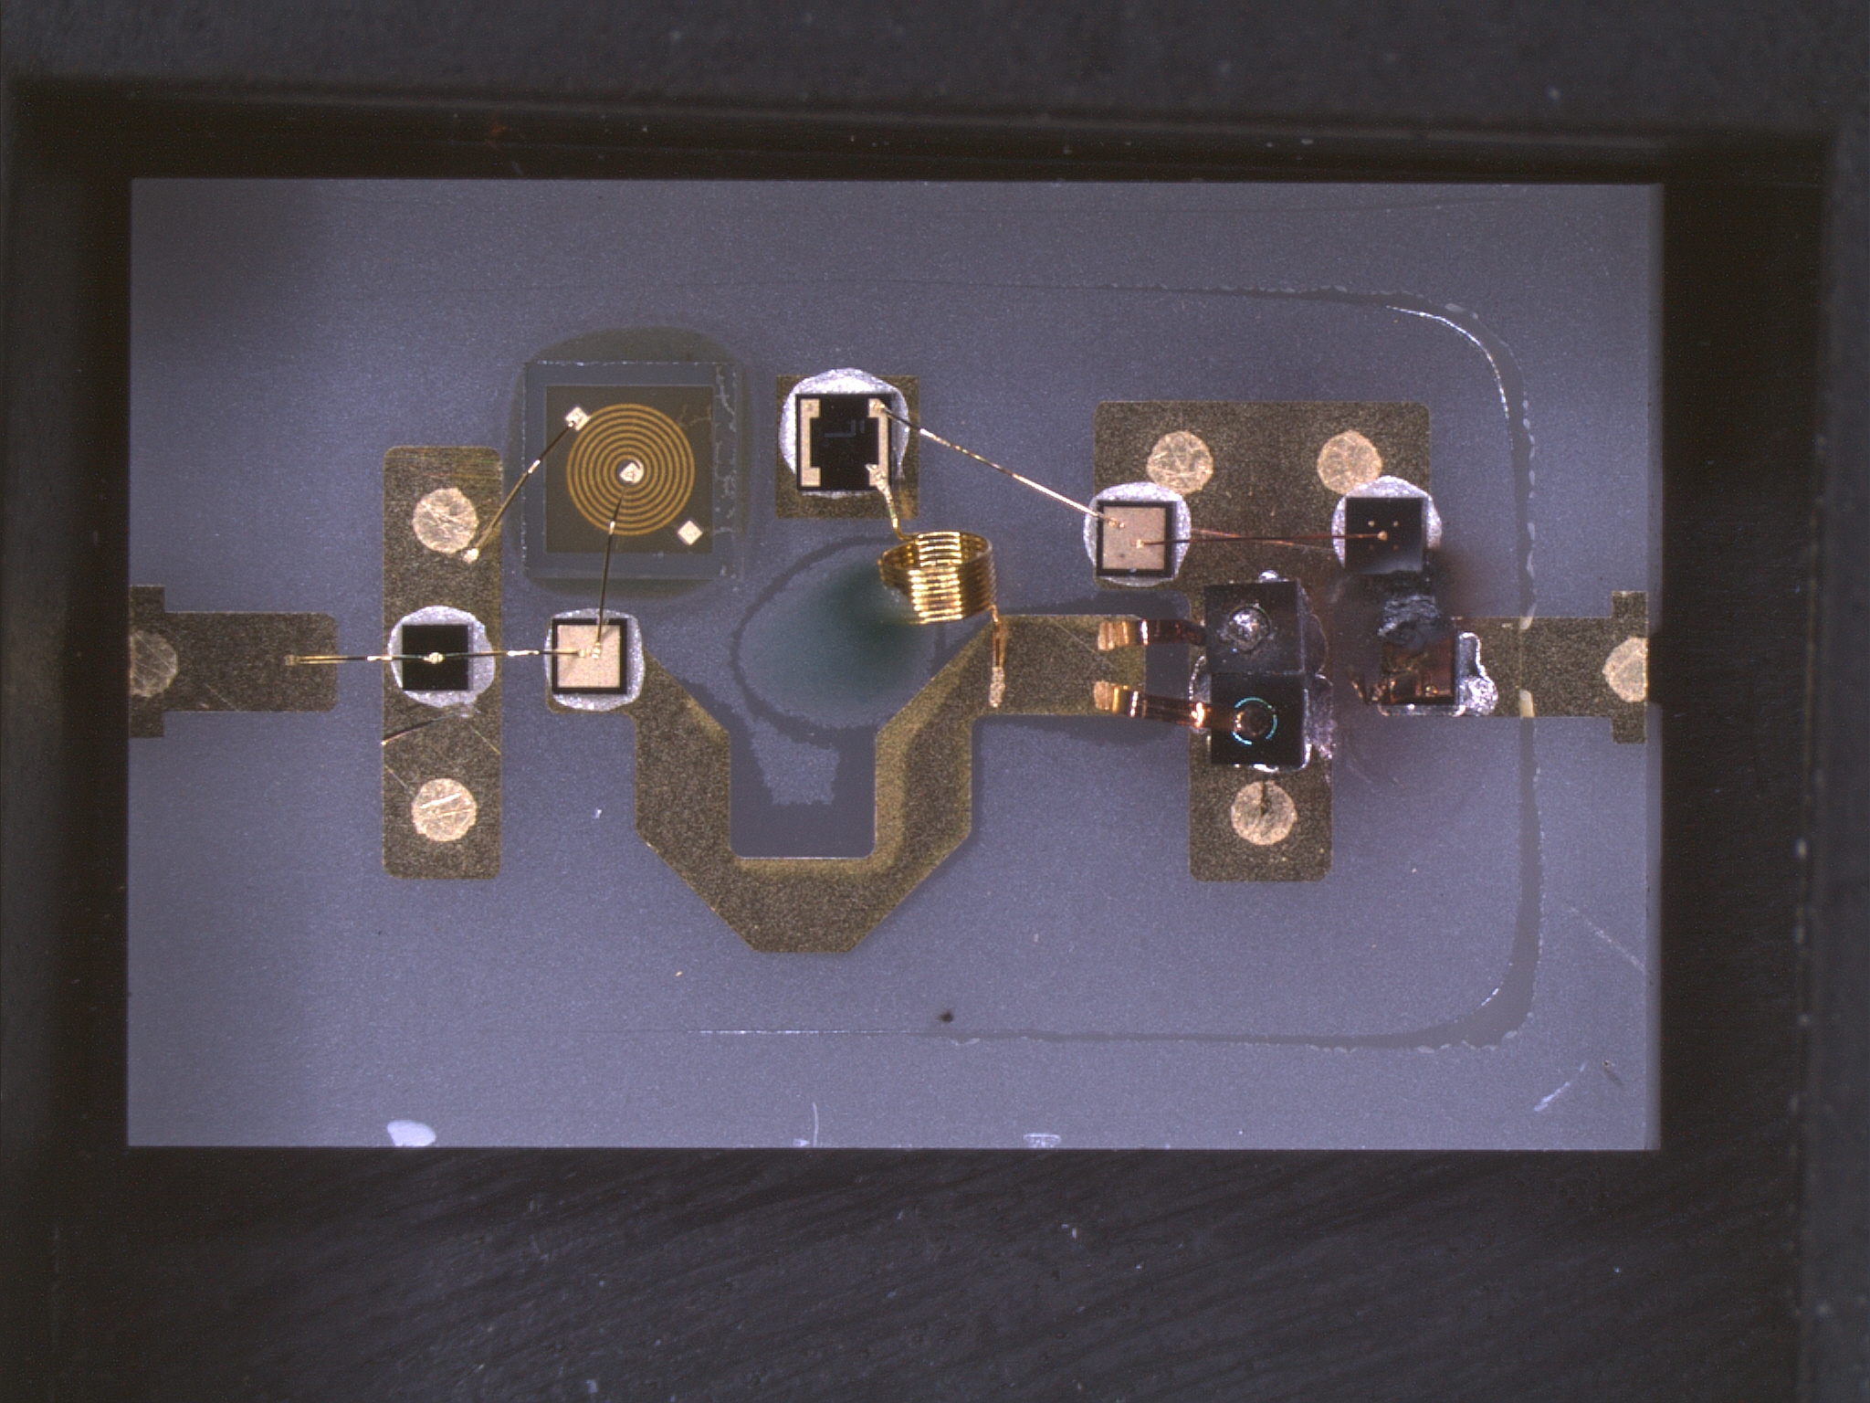
Electrical Overstress: A Very Bad Idea…

Slide 25
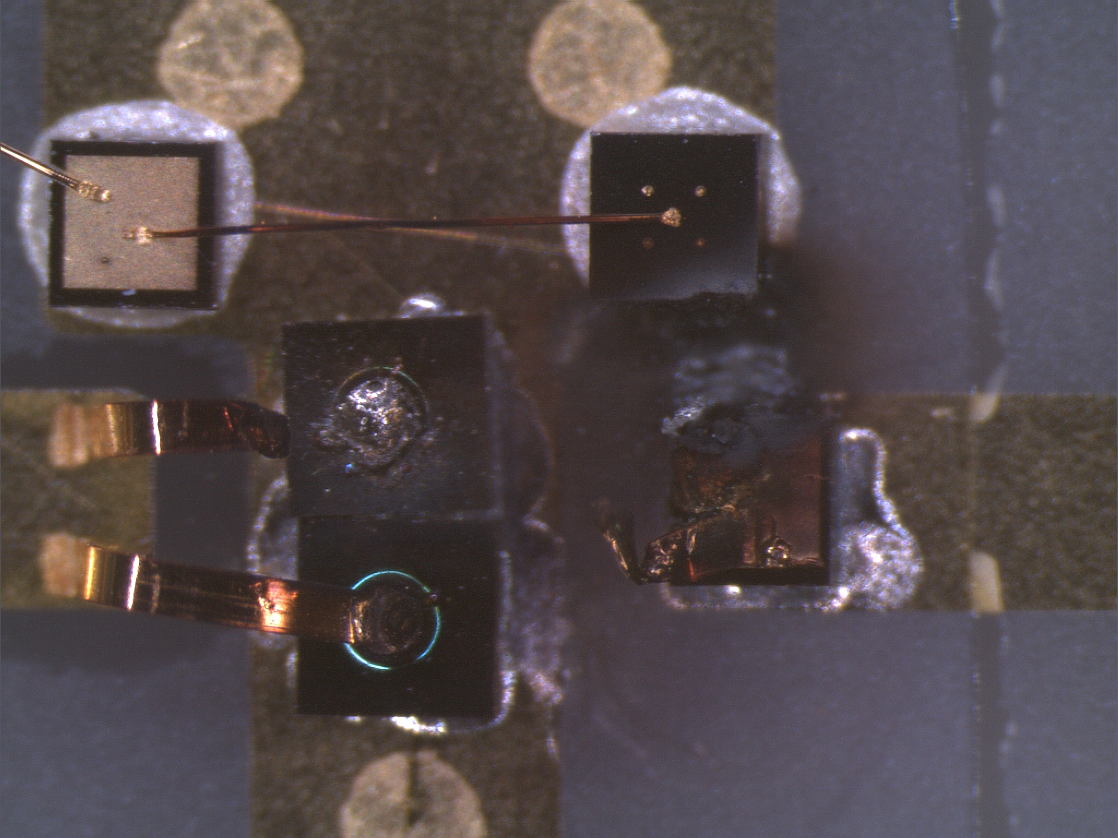
Coarse Limiter Stage Damage Due to Electrical/Thermal Overstress

Slide 26
Summary
A (receiver protector) limiter is a passive device whose insertion loss is controlled by the magnitude of the input signal
Small signal produces low insertion loss (< 1 dB)
Large signal produces large isolation (> 30 dB)
No external control signal is required
MACOM offers limiters comprising our limiter PIN diodes and other components
In order to select a limiter module or diode, we must know:
Frequency range of operation
Peak input power
Pulse width
Duty cycle
Acceptable insertion loss, spike and flat leakage levels

Slide 27
Thank You

